Slide 1
TravelEase - Flight and Train Booking App
A Seamless Travel Experience
Shweta Shivamogga Dattatri
09.01.2024

Slide 2
Agenda
Project Overview
Architecture
Data Model & ER Diagram
Key Features
Q & A

Slide 3
Project Overview
TravelEase is a comprehensive web and mobile application designed to simplify and enhance the travel booking experience. Users can seamlessly book flights and trains, access loyalty programs, and enjoy various services tailored to their preferences.
Goals and Objectives:
Streamline booking processes
Enhance user experience with additional services
Integrate loyalty programs for user benefits

Slide 4
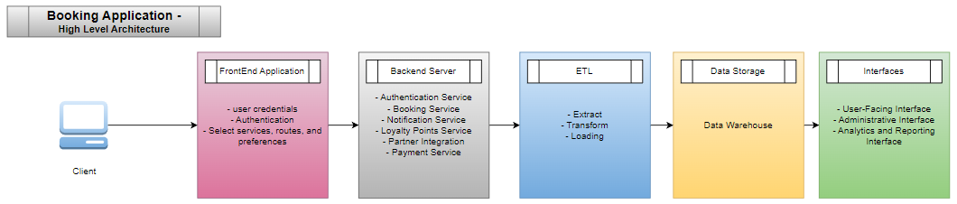
Architecture
High-Level Architecture Diagram:

Slide 5
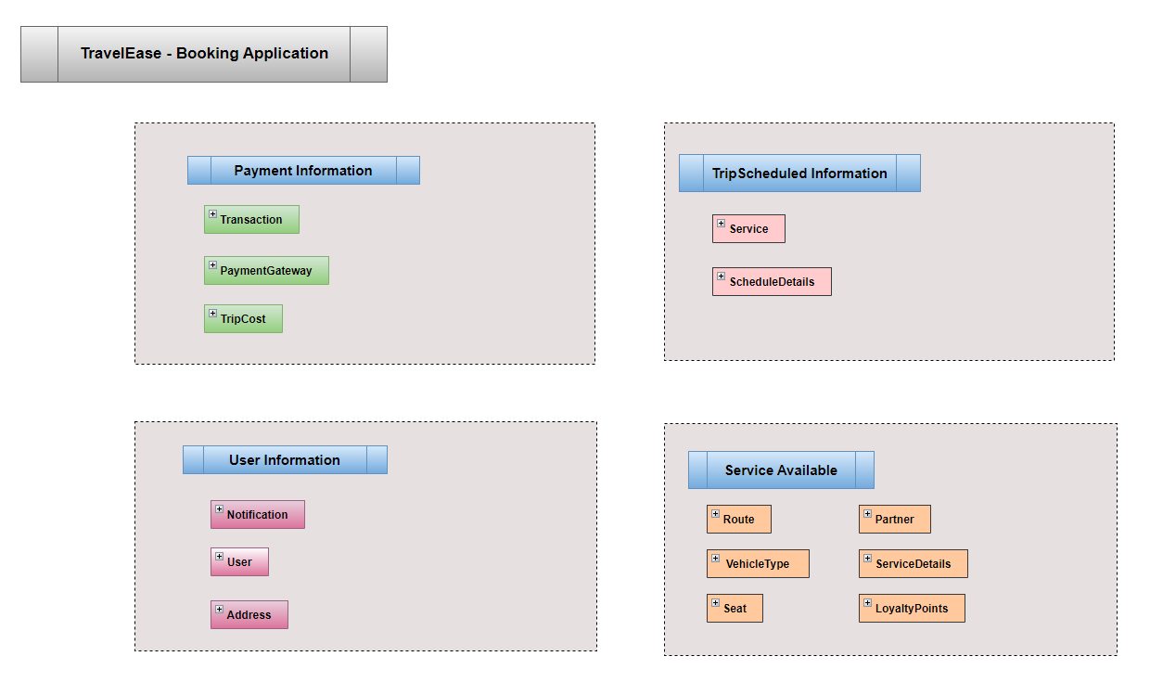
Data Model & ER Diagram
Entity-Relationship (ER) Diagram:
Link : Entity-Relationship (ER) Diagram

Slide 6
Key Features
Flight/Train Booking
Category Selection
One-Way and Return Booking
Extra Services (Loyalty Points, Notifications)
Partners and Loyalty Programs

Slide 7
Q & A

Slide 8
Thank you

